Slide 1
INHERITANCE AND POLYMORHISM

Slide 2
Super class, sub class, inheritance and member access
Inheritance allows a software developer to derive a new class from an existing one
The existing class is called the parent class, or superclass, or base class
The derived class is called the child class or subclass.
As the name implies, the child inherits characteristics of the parent
That is, the child class inherits the methods and data defined for the parent class

Slide 3
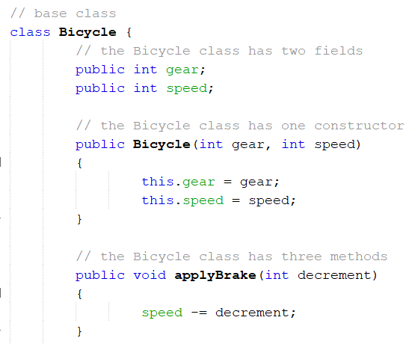
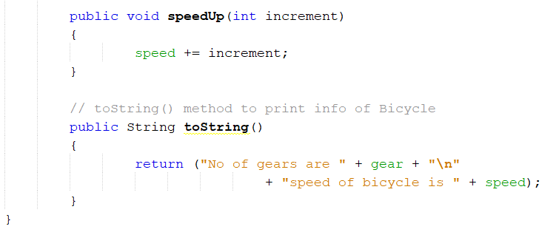

Slide 4
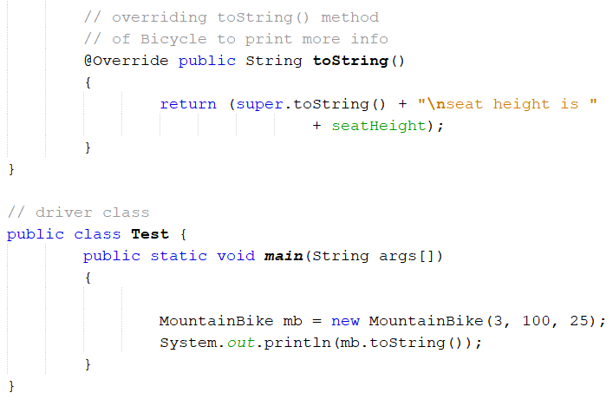

Slide 6
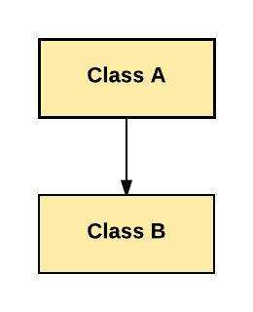
Types of Inheritance
Single Inheritance:

Slide 7
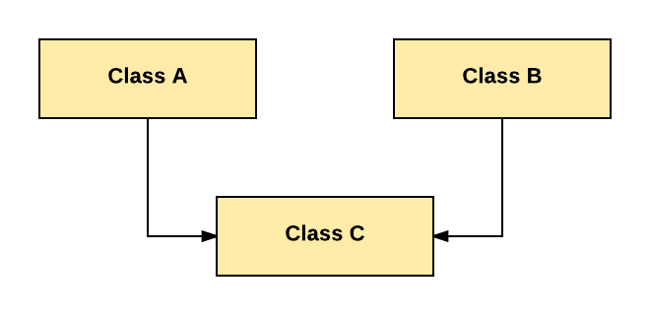
Multiple Inheritance:

Slide 8
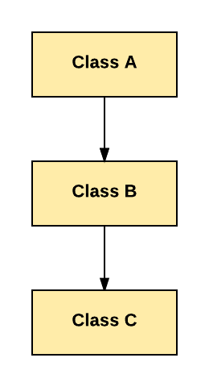
Multilevel Inheritance:

Slide 9
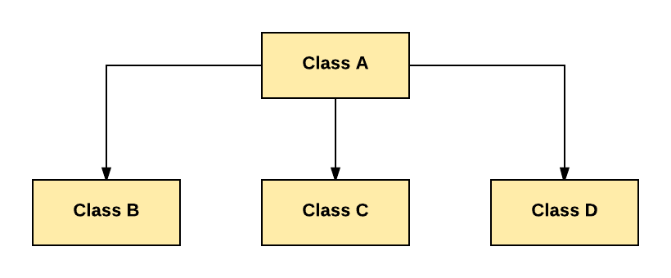
Hierarchical Inheritance:

Slide 10
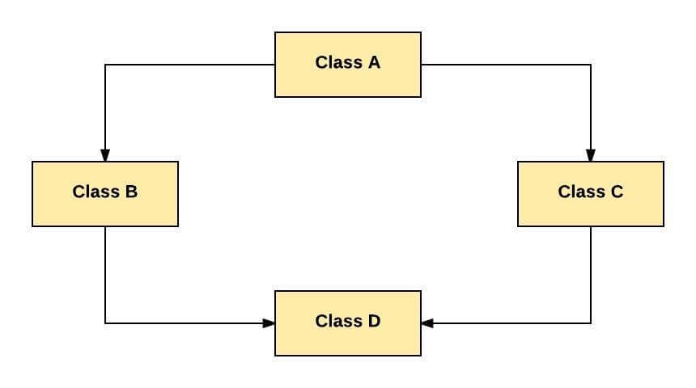
Hybrid Inheritance:

Slide 11
Example: Shared Functionality
public class Student {
String name;
char gender;
Date birthday;
Vector<Grade> grades;
double getGPA() {
…
}
int getAge(Date today) {
…
}
}
public class Professor {
String name;
char gender;
Date birthday;
Vector<Paper> papers;
int getCiteCount() {
…
}
int getAge(Date today) {
…
}
}

Slide 12
public class Person {
String name;
char gender;
Date birthday;
int getAge(Date today) {
…
}
}
public class Student extends Person {
Vector<Grade> grades;
double getGPA() {
…
}
}
public class Professor extends Person {
Vector<Paper> papers;
int getCiteCount() {
…
}
}

Slide 13
Overriding methods
When a method in a subclass has the same name and type signature as a method in its superclass , then the method in a subclass is said to override the method the method in the superclass.
When an overridden method is called from within a subclass, it will always refer to the version of that method defined by the subclass.
The version of the method defined by the superclass will be hidden.

Slide 14
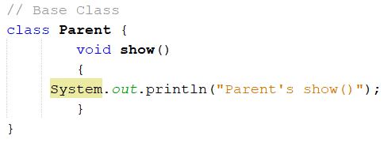
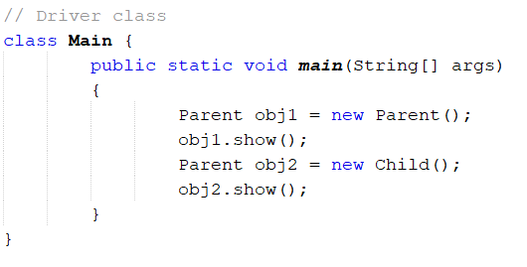
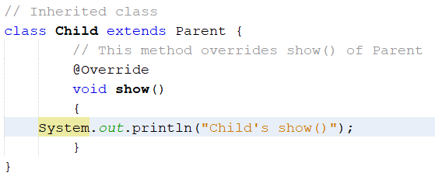

Slide 15
Final classes and methods
To prevent a class from being inherited, precede the class declaration with final.
final class A
{
//……..
}
//the following class is illegal
Class B extends A { //ERROR! Cant’t subclass A
}

Slide 16
Methods
To prevent a method from being overridden, precede the method declaration with final.
Class A{
inal void method()
{
System.out.println(“This is a final method”);
}
}
Class B extends A
{
Void method() //Error! Can’t override
{
System.out.println(“Illegal !”);
}}

Slide 17
The Object class
Object class is the parent class of all the classes in java by default
topmost class of java
Object class is present in java.lang package
Every class in Java is directly or indirectly derived from the Object class
If a Class does not extend any other class then it is direct child class of Object and if extends other class then it is an indirectly derived.
Therefore the Object class methods are available to all Java classes.
Hence Object class acts as a root of inheritance hierarchy in any Java Program.

Slide 18
Methods of Object class
Method | Description
public final Class getClass() | returns the Class class object of this object. The Class class can further be used to get the metadata of this class.
public int hashCode() | returns the hashcode number for this object.
public boolean equals(Object obj) | compares the given object to this object.
protected Object clone() throws CloneNotSupportedException | creates and returns the exact copy (clone) of this object.
public String toString() | returns the string representation of this object.
public final void notify() | wakes up single thread, waiting on this object's monitor.
public final void notifyAll() | wakes up all the threads, waiting on this object's monitor.
public final void wait(long timeout)throws InterruptedException | causes the current thread to wait for the specified milliseconds, until another thread notifies (invokes notify() or notifyAll() method).
public final void wait(long timeout,int nanos)throws InterruptedException | causes the current thread to wait for the specified milliseconds and nanoseconds, until another thread notifies (invokes notify() or notifyAll() method).
public final void wait()throws Interrupted Exception | causes the current thread to wait, until another thread notifies (invokes notify() or notifyAll() method).
protected void finalize()throws Throwable | is invoked by the garbage collector before object is being garbage collected.

Slide 19
Object Cloning
object cloning is a way to create exact copy of an object.
clone() method of Object class is used
java.lang.Cloneable interface must be implemented by the class whose object clone we want to create. If we don't implement Cloneable interface, clone() method generates CloneNotSupportedException.
The clone() method is defined in the Object class. Syntax of the clone() method is as follows:
protected Object clone() throws CloneNotSupportedException

Slide 20
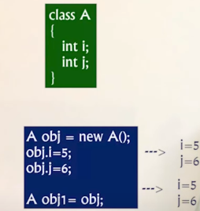
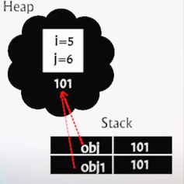
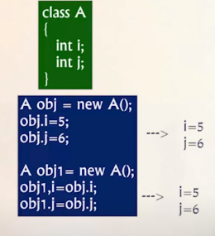
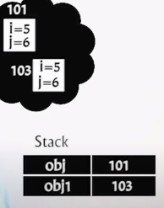
Three types of Copying object:
Shallow copy
Point p₀ = new Point(10,20);
Point p₁ = p₀;
Deep copy
Point p₀ = new Point(10,20);
Point p₁ = new Point()
p_{1.}.x = 10;
p_{1.}.y = 20;

Slide 21
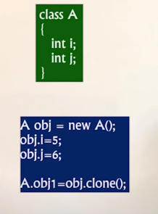
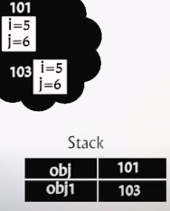

Cloning

Slide 22
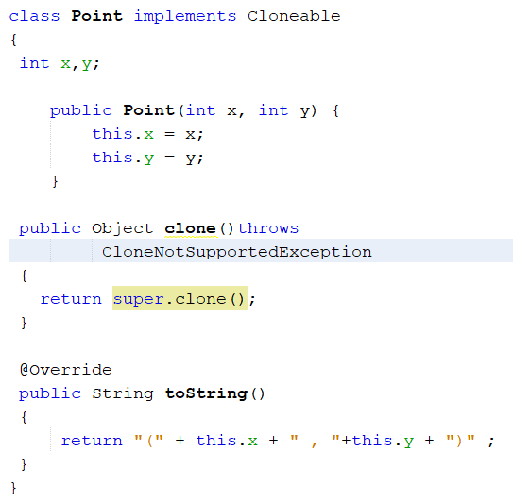
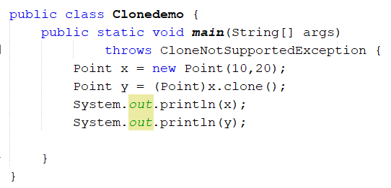

Slide 23
Abstract classes
A class that is declared with the reserved word abstract in its heading
An abstract class can contain instance variables, constructors, finalizers, and non-abstract methods
An abstract class can contain abstract methods
If a class contains an abstract method, the class must be declared abstract
cannot instantiate an object of an abstract class type; can only declare a reference variable of an abstract class type
can instantiate an object of a subclass of an abstract class, but only if the subclass gives the definitions of all the abstract methods of the superclass

Slide 24
Abstract methods
A method that has only the heading with no body
Must be implemented in a subclass
Must be declared abstract
public double abstract area();
public void abstract print();
public abstract object larger(object , object);
void abstract insert(int insert_Item);

Slide 25
public abstract class AbstractClassExample
{
protected int x;
public AbstractClassExample()
{
x = 0;
}
public void abstract print();
public void set_X(int a)
{
x = a;
}
}

Slide 26
Creating and using interface
A class that contains only abstract methods and/or named constants
How Java implements multiple inheritance
To be able to handle a variety of events, Java allows a class to implement more than one interface
does not contain any concrete methods (methods that have code). All the methods of an interface are abstract methods.
interface cannot be instantiated. However, classes that implement interfaces can be instantiated. Interfaces never contain instance variables but, they can contain public static final variables (i.e., constant class variables)

Slide 27
Method overloading
Method Overloading is a feature that allows a class to have more than one method having the same name, if their argument lists are different.
It is similar to constructor overloading in Java, that allows a class to have more than one constructor having different argument lists.
For example the argument list of a method add(int a, int b) having two parameters is different from the argument list of the method add(int a, int b, int c) having three parameters.

Slide 28
Three ways to overload a method
In order to overload a method, the argument lists of the methods must differ in either of these:
Number of parameters.
add(int, int)
add(int , int , int)
Data type of parameters
add(int , int)
add(int , float)
Sequence of Data type of parameters.
add(int , float)
add(float , int)

Slide 29
Upcasting and downcasting
Upcasting
Upcasting is the typecasting of a child object to a parent object. Upcasting can be done implicitly.
Upcasting gives us the flexibility to access the parent class members but it is not possible to access all the child class members using this feature.
Instead of all the members, we can access some specified members of the child class. For instance, we can access the overridden methods.

Slide 30
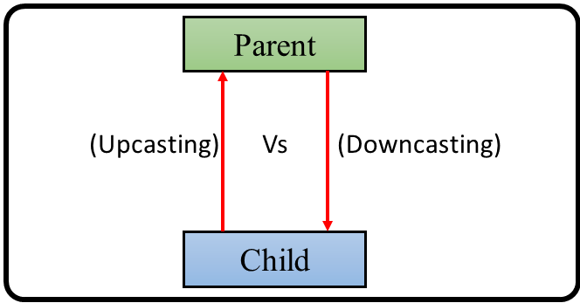

Slide 31
Downcasting
downcasting means the typecasting of a parent object to a child object.
Downcasting cannot be implicitly.
After defining these type of casting explicitly, the compiler checks in the background if this type of casting is possible or not. If it’s not possible, the compiler throws a ClassCastException.

Slide 32
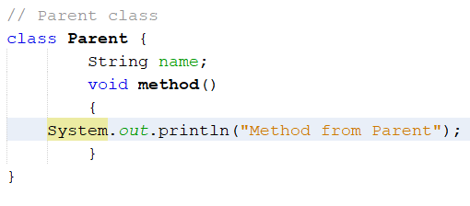
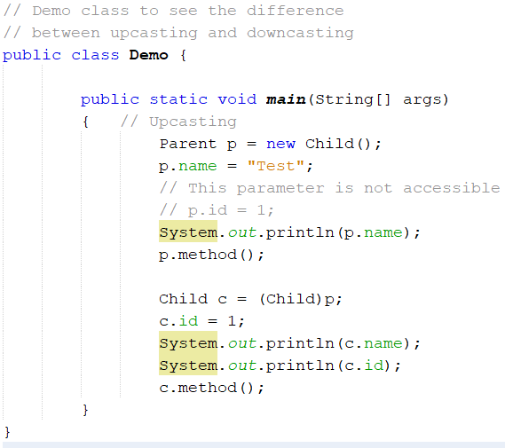
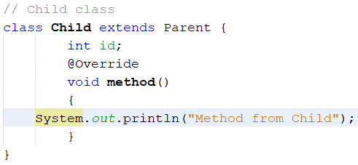

Slide 33
Object equivalence
Java Object class is the super class of all the Java classes. All Java classes implements the Object class by default.
The Java Object class provides the two important methods
to compare two objects in Java, i.e. equals() and hashCode() method.
Java equals() Method
Java hashCode() Method

Slide 34
Overriding equals() Method
The equals() method of the Object class compare the equality of two objects.
The two objects will be equal if they share the same memory address.
Syntax:
public boolean equals(Object obj)

Slide 35
hashCode() Method
hash code is a 32-bit signed integer value. It is a unique id provided by JVM to Java object.
Each Java object is associated with the hash code. The hash code is managed by a hash-based data structure, such as HashTable, HashSet, etc.
When we override the equals() method, it is necessary to override the hashCode() method.
Syntax:
public int hashCode()
It returns a randomly generated hash code value of the object that is unique for each instance. The randomly generated value might change during the several executions of the program.

Slide 36
import java.util.LinkedHashSet;
public class Person {
public String name;
public int age;
public Person(String name, int roll) {
this.name = name;
this.age = roll;
}
}

Slide 37
class Student extends Person
{
int roll;
public Student(String name, int age ,int roll) {
super(name, age);
this.roll = roll;
}
@Override
public int hashCode()
{
return this.roll;
}
@Override
public boolean equals(Object obj) {
Student obj1 = (Student)obj ; ///Downcasting
return this.name.equals(obj1.name) && this.age==obj1.age && this.roll==obj1.roll;
}

Slide 38
@Override
public String toString() {
return this.name + " " + this.age + " " +this.roll;
} }
class EqualHashcodetoStringDemo{
public static void main(String[] args) {
Student s1 = new Student("ram", 20, 1);
Student s2 = new Student("ram", 20, 1);
Student s3 = new Student("sita", 20, 1);
Student s4 = new Student("ram", 20, 4);
LinkedHashSet <Student> student = new LinkedHashSet<>();
student.add(s1);
student.add(s2);
student.add(s3);
student.add(s4);
student.forEach((s) -> { //functional operation
System.out.println(s);
});}}

